Slide 1
When do you need a database?
Lots of data?
Ad hoc queries
Concurrent transactions

Slide 2
New revolution
SQL and NoSQL databases
Relational and Polyglot databases
Web has changed everything

Slide 3
Teaching method - material
You can read this anywhere, I will provide recommended references
But…..and you know it, studying today means

Slide 4
Studying today
http://lmgtfy.com/?q=SQL

Slide 5
Big Picture
Database field is undergoing dramatic transformation
The way we used to teach it for years and years…and years, it is no longer useful. Or not as useful as it used to be
Why?

Slide 6
Why?
E.F Codd (Relational Model of data, 1970) used to be the bible of databases for 30+ years
Not anymore!

Slide 7
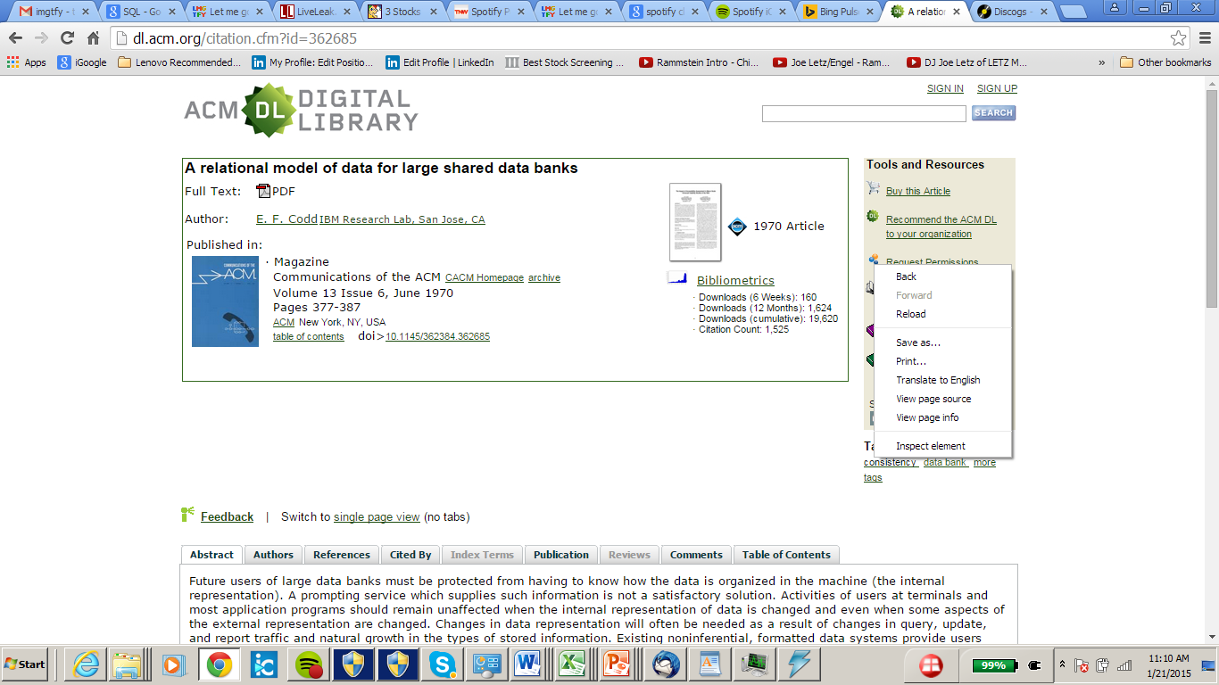
The paper

Slide 8
Abstract of the paper
Future users of large data banks must be protected from having to know how the data is organized in the machine (the internal representation) (..)
Activities of users at terminals and most application programs should remain unaffected when the internal representation of data is changed and even when some aspects of the external representation are changed (…)
Existing noninferential, formatted data systems provide users with tree-structured files or slightly more general network models of the data.

Slide 9
Abstract (cnt)
In Section 1, inadequacies of these models are discussed. A model based on n-ary relations, a normal form for data base relations, and the concept of a universal data sublanguage are introduced.
In Section 2, certain operations on relations (other than logical inference) are discussed and applied to the problems of redundancy and consistency in the user's model.

Slide 10
The “commandments” of Relational Databases
Data Independence
Data Normalization
Data-centric programming languages – called QUERY LANGUAGES
Programmer Productivity! SQL
Declarative not procedural

Slide 11
…are seriously questioned
And there is one word for it
NoSQL

Slide 12
History goes in circles
E.F Codd in his landmark paper criticized pre-1970 databases for lack of clear query languages, data independence and de-normalized data
But this is almost precisely what NoSQL databases are!
BACK TO THE FUTURE?

Slide 13
Whats new?
High Performance, Web demands
Hundreds if not thousands of simple queries per second
Data is complex, lots of text, semi-structured data and structured data

Slide 14
So here goes….
SQL – in web applications, no need for AdHoc queries.
Who cares about programmer productivity?
There are plenty of programmers who program as fast as they write

Slide 15
Code, not Codd, is the king!
NoSQL – coding, both on “physical layer” (for example managing clusters, indexing, hashing along with “logic”). No more Codd’s separation of logical and physical layers of data

Slide 16
Have you ever seen an SQL query?
SELECT s.bar FROM sells s JOIN beer b ON s.beer = b.name
WHERE b.manf = X AND
EXISTS( SELECT * FROM frequents f
JOIN likes l ON l.drinker = f.drinker JOIN beer b1 ON b1.name = l.beer
WHERE f.bar = s.bar AND b1.manf = b.manf)
All bars that serve a beer from manufacturer X and are frequented by at least one person that likes a beer from that manufacturer.

Slide 17
SQL programmer
Does not have to know how data is stored
On a cluster?
On a single machine?
Hash tables, indexes?

Slide 18
Declarative means…
What, not How
The SQL execution engine and optimizer takes care of the “details”

Slide 19
Not any more in NoSQL!
Luxuries are gone, hard core coding
But better performance as this counts
PROCEDURAL: like java, c etc

Slide 20
Do You Know SQL?
TAKES[Student, Class]
Find all students who do not take databases?

Slide 21
Teaching SQL
You will have access to a database and use MySQL
Install Mysql query browser
Practice on that database.
We will use AWS. Instructions on sakai + recitations.

Slide 22
What is a Data Model?
Mathematical representation of data.
  Examples: relational model = tables; semistructured model = trees/graphs.
Operations on data.
Constraints.

Slide 23
A Relation is a Table
Attributes
(column
headers)
name manf
Winterbrew Pete’s
Bud Lite Anheuser-Busch
Beers
Tuples
(rows)
Relation
name

Slide 24
Schemas
Relation schema = relation name and attribute list.
  Optionally: types of attributes.
  Example: Beers(name, manf) or Beers(name: string, manf: string)
Database = collection of relations.
Database schema = set of all relation schemas in the database.

Slide 25
Why Relations?
Very simple model.
Often matches how we think about data.
Abstract model that underlies SQL, the most important database language today.

Slide 26
Our Running Example
Beers(name, manf)
Bars(name, addr, license)
Drinkers(name, addr, phone)
Likes(drinker, beer)
Sells(bar, beer, price)
Frequents(drinker, bar)
Underline = key (tuples cannot have the same value in all key attributes).
  Excellent example of a constraint.

Slide 27
Database Schemas in SQL
SQL is primarily a query language, for getting information from a database.
But SQL also includes a data-definition component for describing database schemas.

Slide 28
Creating (Declaring) a Relation
Simplest form is:
CREATE TABLE <name> (
<list of elements>
);
To delete a relation:
DROP TABLE <name>;

Slide 29
Elements of Table Declarations
Most basic element: an attribute and its type.
The most common types are:
  INT or INTEGER (synonyms).
  REAL or FLOAT (synonyms).
  CHAR(n ) = fixed-length string of n characters.
  VARCHAR(n ) = variable-length string of up to n characters.

Slide 30
Example: Create Table
CREATE TABLE Sells (
bar CHAR(20),
beer VARCHAR(20),
price REAL
);

